Slide 1





Composition and decomposition of task representations in visuomotor adaptation
James Mathew
07-12-2020

Slide 2


Data collected in Marseille
People involved
Frederic Danion
Institut de Neurosciences de la Timone,
Aix-Marseille Universite, Marseille, France
Pierre-Michel Bernier
Département de Kinanthropologie,
Université de Sherbrooke, Québec, Canada

Slide 3
Today’s talk
Introduction
Methods
Results
Discussion

Slide 4
Introduction
Kinematic vs dynamic learning
Dynamics is the study of motion that result from forces.
Kinetics is the study of motion of a body which is caused by inertial force and mass of that body.
Kinematics is the study of motion without regard to forces that cause it
In the field of motor adaptation,
Kinematic learning (visuomotor rotation, learning rely more on visuo-proprio mismatch/ visual feedback)
Dynamic learning (intertial/force field, learning rely more on proprioceptive/kinesthetic feedback)
Combined learning (combination of different perturbation in a single movement/ trial)
Kinematic + Dynamic perturbations
Visuomotor rotation + Forcefield (Flanagan 1999)
Visuomotor rotation + Elastic force (Burgos et al 2018)
Visuomotor rotation + Inertial force (Krakeur 1999)
Kinematic + kinematic perturbations
Visuomotor rotation + mass-spring-NOhaptic in a single trial
Instead of goal-directed reaching movements, we do online tracking tasks/continuous movements.

Slide 5
Introduction
Modularity
Ability to compose and decompose skills/ adaptation (Flanagan et al, 1999; Haruno et al, 2001; Howard et al, 2008)
Composition : Task A→Task B → Task AB?
Decomposition : Task AB→ Task A?→Task B?
Visuomotor rotation +Viscous forcefield (Flanagan 1999)
Comp : VR → FF →VR+FF
FF → VR →VR+FF
Decomp : VR+FF → VR
VR+FF → FF
Previous learning benefit. In decomposition, more benefit to VR than FF
Decomposition benefit to the kinematic adaptation but found no transfer for the dynamic adaptation.
Visuomotor rotation + Elastic force (Burgos et al 2018)
Kinematic and dynamic skill components can be learned separately and then accurately combined.
Kinematic skill is more transferable than dynamic skill
Visuomotor rotation + Mass-Spring

Slide 6
Introduction
Interference:
The phenomena that limits our ability to learn multiple tasks in close succession.
Often studied with (A1→B->A2) paradigm: a subject is instructed to serially learn Task A, Task B, and then Task A
Task B is usually made to be the opposite of Task A.
It is a sign of active “unlearning,” needed when a transformation rule must be deleted from memory to make place for an alternative one (Brashers-Krug et al.1996)
retrograde interference: learning something new causes forgetting of an older memory - how Task B interferes with the memory of Task A1
anterograde interference : learning a new task disrupts learning of a 2nd subsequent task- how the memory of Task A1 interferes with the subsequent learning of Task B (or how B interferes with A2). Note that both retrograde and anterograde interference can affect performance in Task A2. (Sing & Smith 2010)
Interference occurs ,
When error signals for each perturbation are encoded via the same sensory modality (proprioception, vision) or within the same reference frame (intrinsic, extrinsic) (Krakauer et al. 1999).
When the state variables (pos,vel,acc) of the perturbations are dependent (Tong et al 2002)
When the two perturbations affect movements that are directed toward a common goal, or when they share common motor preparatory activity (Howard et al. 2012; Krakauer et al. 2019; Sheahan et al. 2016)
Source of interference is competition of neural resources, although the neuronal mechanisms are unknown.

Slide 7
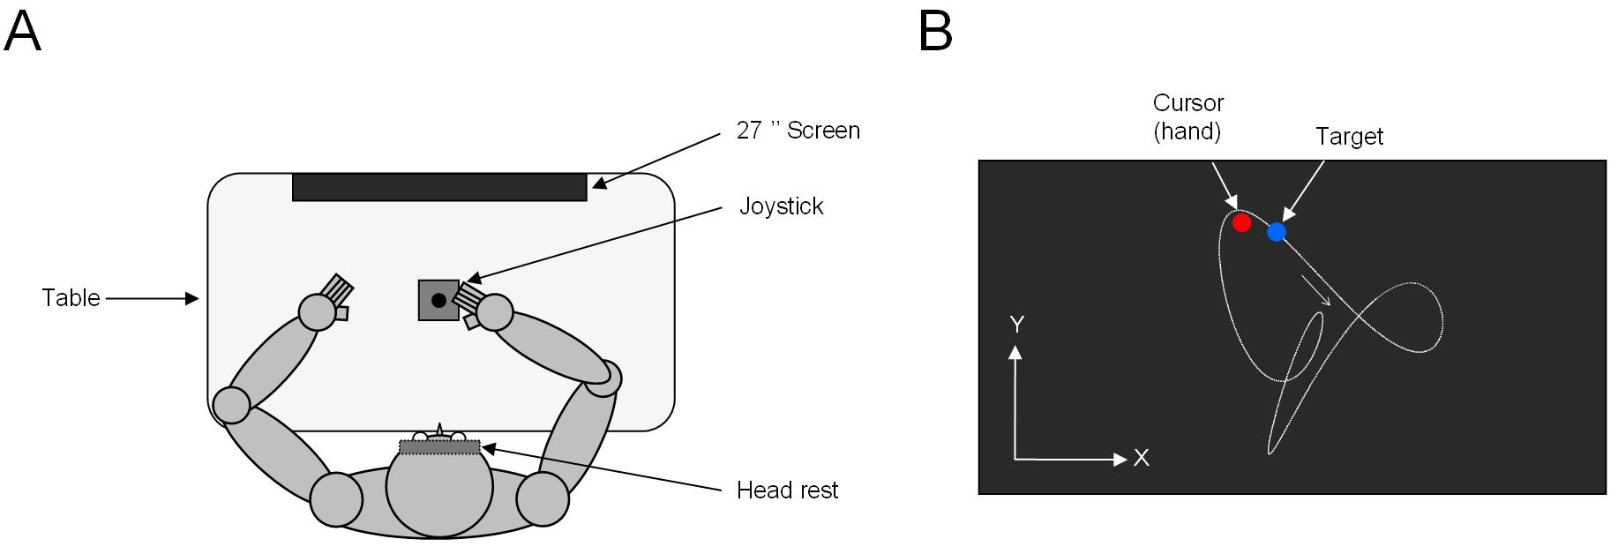
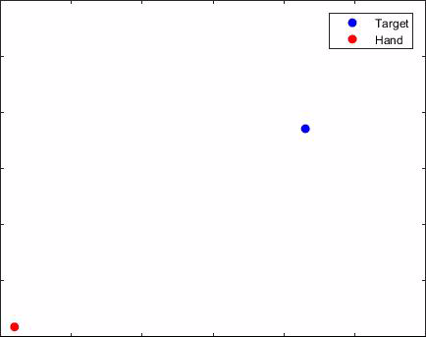
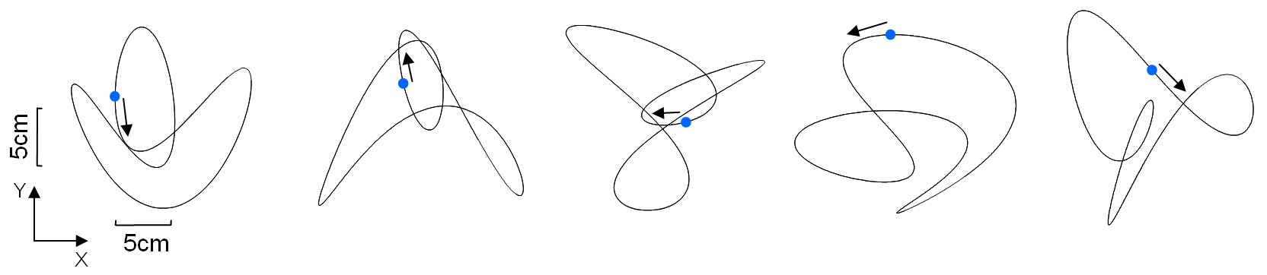
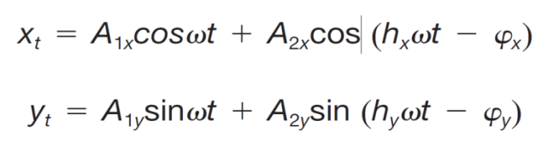
Objective & Experimental set-up
Objective: To investigate interference effect and modularity of sensorimotor adaptation in manual tracking under two separate visual perturbations (SPRING and ROTATION) and their combination (SPRING+ROTATION).
Normal mapping (Baseline)

Slide 8
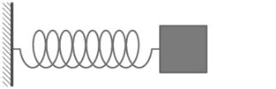
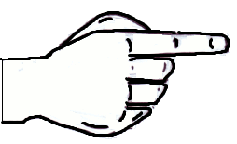
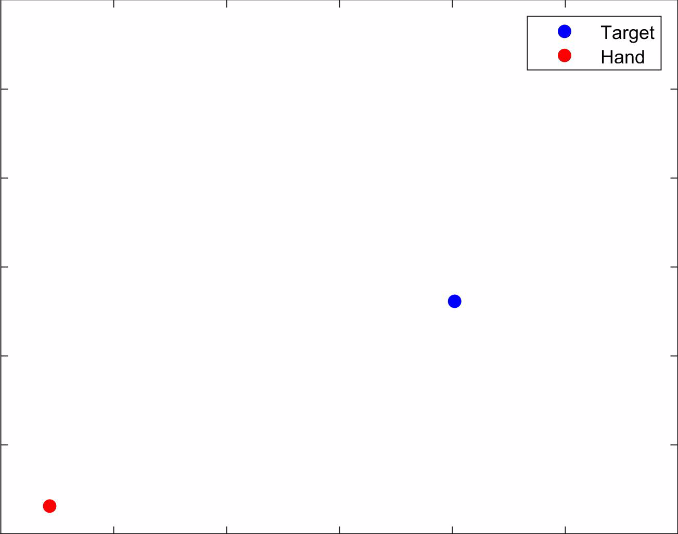
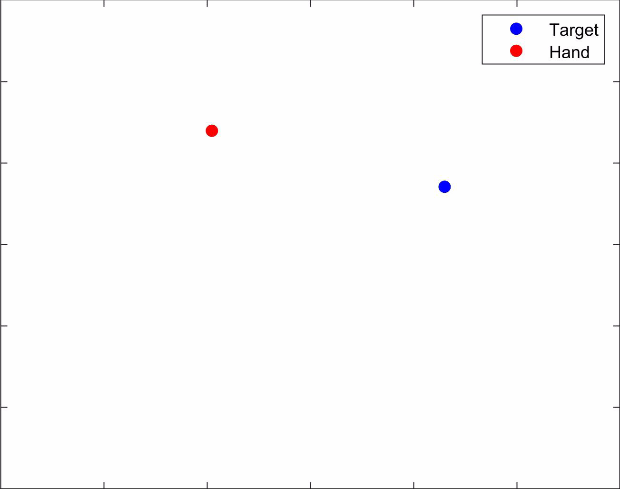
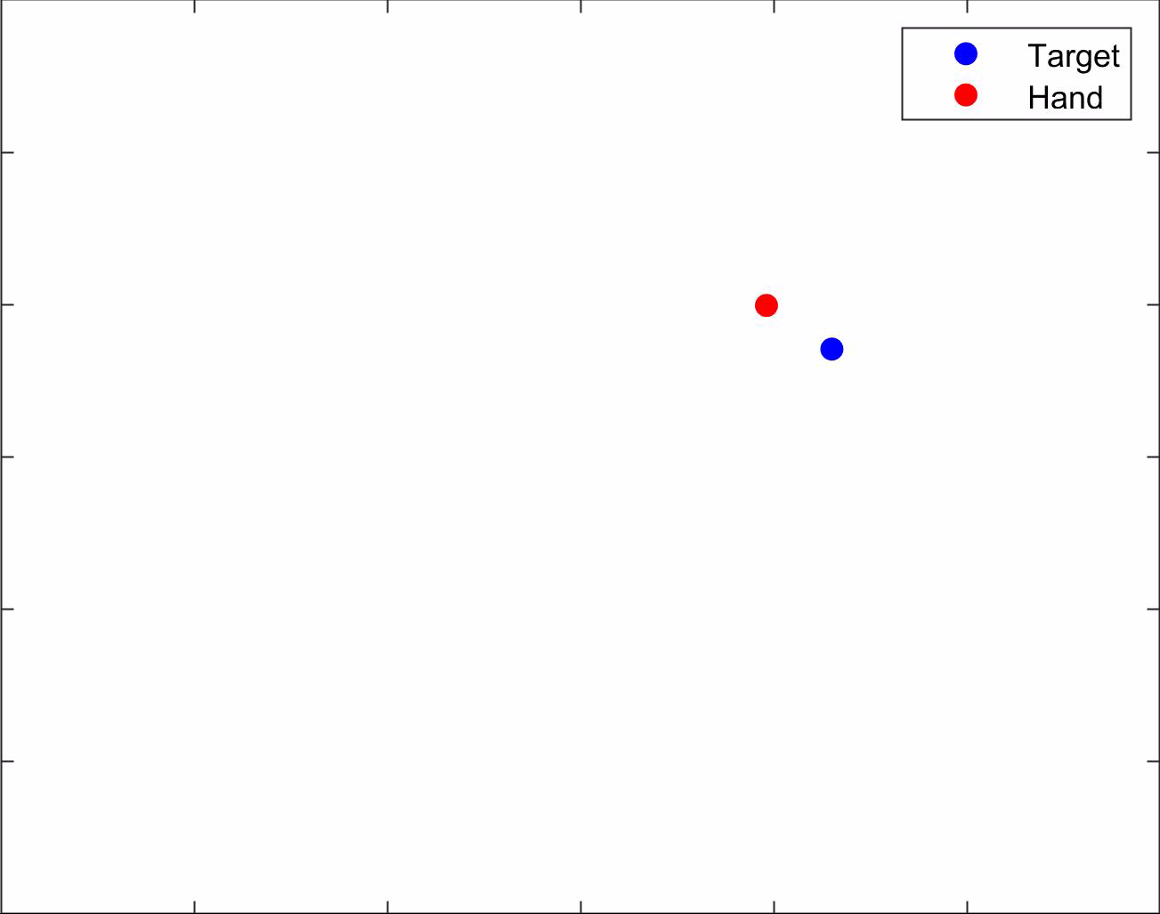
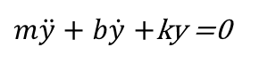
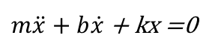
Experimental Conditions
Rotation (ROT)
Spring (SPR)
Rotation+Spring (SPROT)
Hand
Cursor
Mass : m=1Kg
Stiffness : k=30N.m⁻¹
Damping: b=1.7N.m⁻¹.s⁻¹
Hand
Cursor
90°
Cursor
90°
Hand
$m\ddot{x}+b\dot{x}$ + kx =0
Cursor
$m\ddot{y}+b\dot{y}$ +ky =0
Hand
90⁰ counterclockwise rotation between hand & cursor
Mimicking a spring between hand & cursor. (No haptic feedback)

Slide 9
Experimental Design
10 trials
50 trials
50 trials
50 trials
10 trials
Group 1
Normal
Spring
Rotation
Spring+Rotation
Normal
Compose
Group 2
Normal
Rotation
Spring
Spring+Rotation
Normal
Group 3
Normal
Spring+Rotation
Spring
Rotation
Normal
Decompose
Group 4
Normal
Spring+Rotation
Rotation
Spring
Normal
20 right handed naïve participants in each group
Composition
Decomposition
Interference

Slide 10
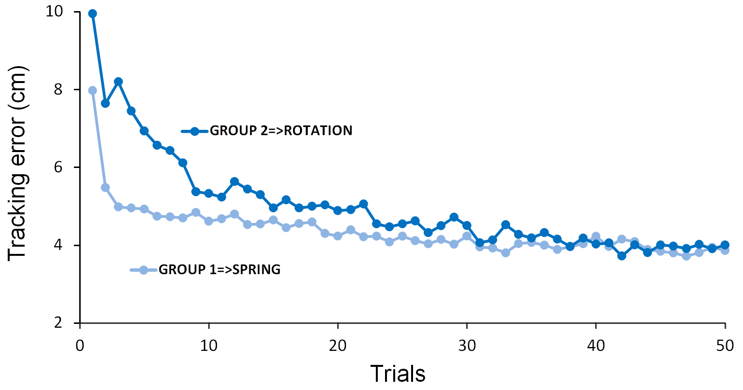
Results : Naïve Behaviour
G1
Spring
Rotation
SPROT
SPROT
mean(G3,G4)
G2
Rotation
Spring
SPROT
Curs-Targ dist (cm)
G3
SPROT
Spring
Rotation
G4
SPROT
Rotation
Spring
Trials
Faster adaptation under the spring mapping
Combined mapping is challenging

Slide 11
Results : Modularity - Composition
ROT
SPR
SPROT
SPROT
Curs-Targ dist (cm)
Naïve (no prior exp) mean(G3,G4)
G1
Spring
Rotation
Spring+Rotation
G2
Rotation
Spring
Spring+Rotation
G3
Spring+Rotation
Spring
Rotation
With prior exp in ROT and SPR – mean(G1,G2)
G4
Spring+Rotation
Rotation
Spring
Trials
Prior experience with the Rotation and Spring mapping provides some benefit to handle the combined mapping !

Slide 12
Results : Modularity - Decomposition
SPROT→ ROT?
→ SPR?
ROTATION
SPRING
Naïve (no prior exp) G2
Curs-Targ dist (cm)
Naïve (no prior exp) G1
G1
Spring
Rotation
SPROT
G2
Rotation
Spring
SPROT
G3
SPROT
Spring
Rotation
With SPROT prior exp G4
With SPROT prior exp G3
G4
Rotation
Spring
SPROT
Trials
Trials
Prior experience with the combined mapping does provide some benefit to handle each mapping separately!

Slide 13
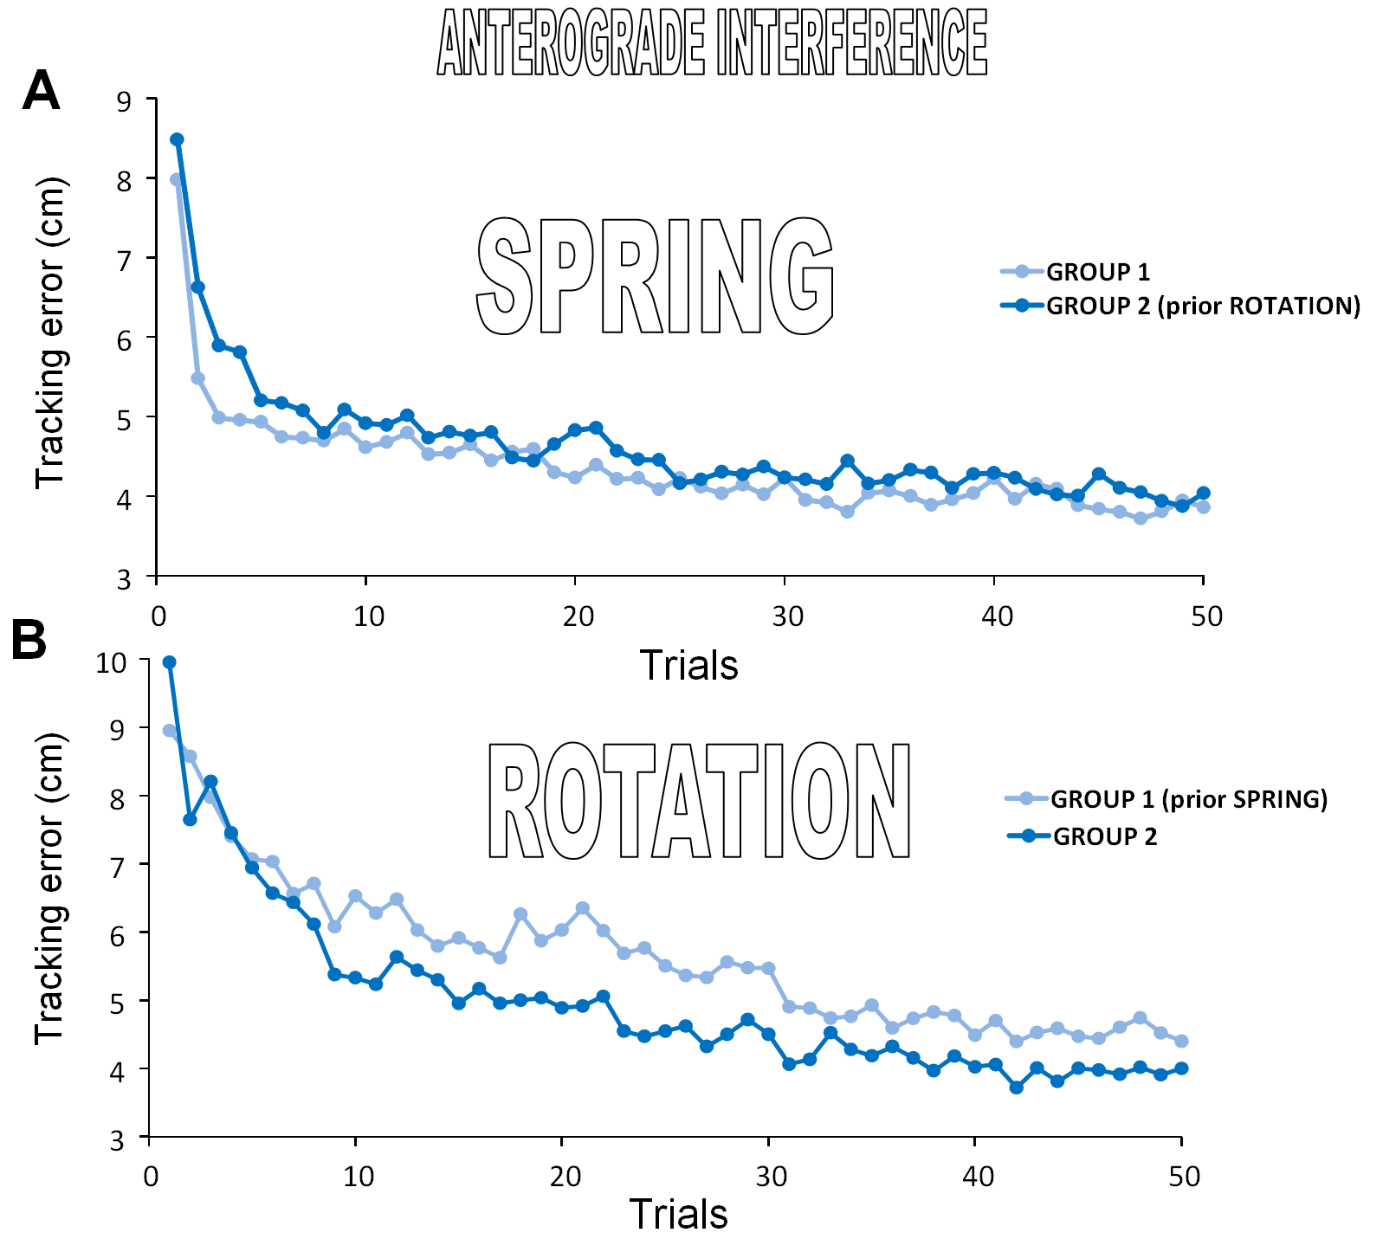
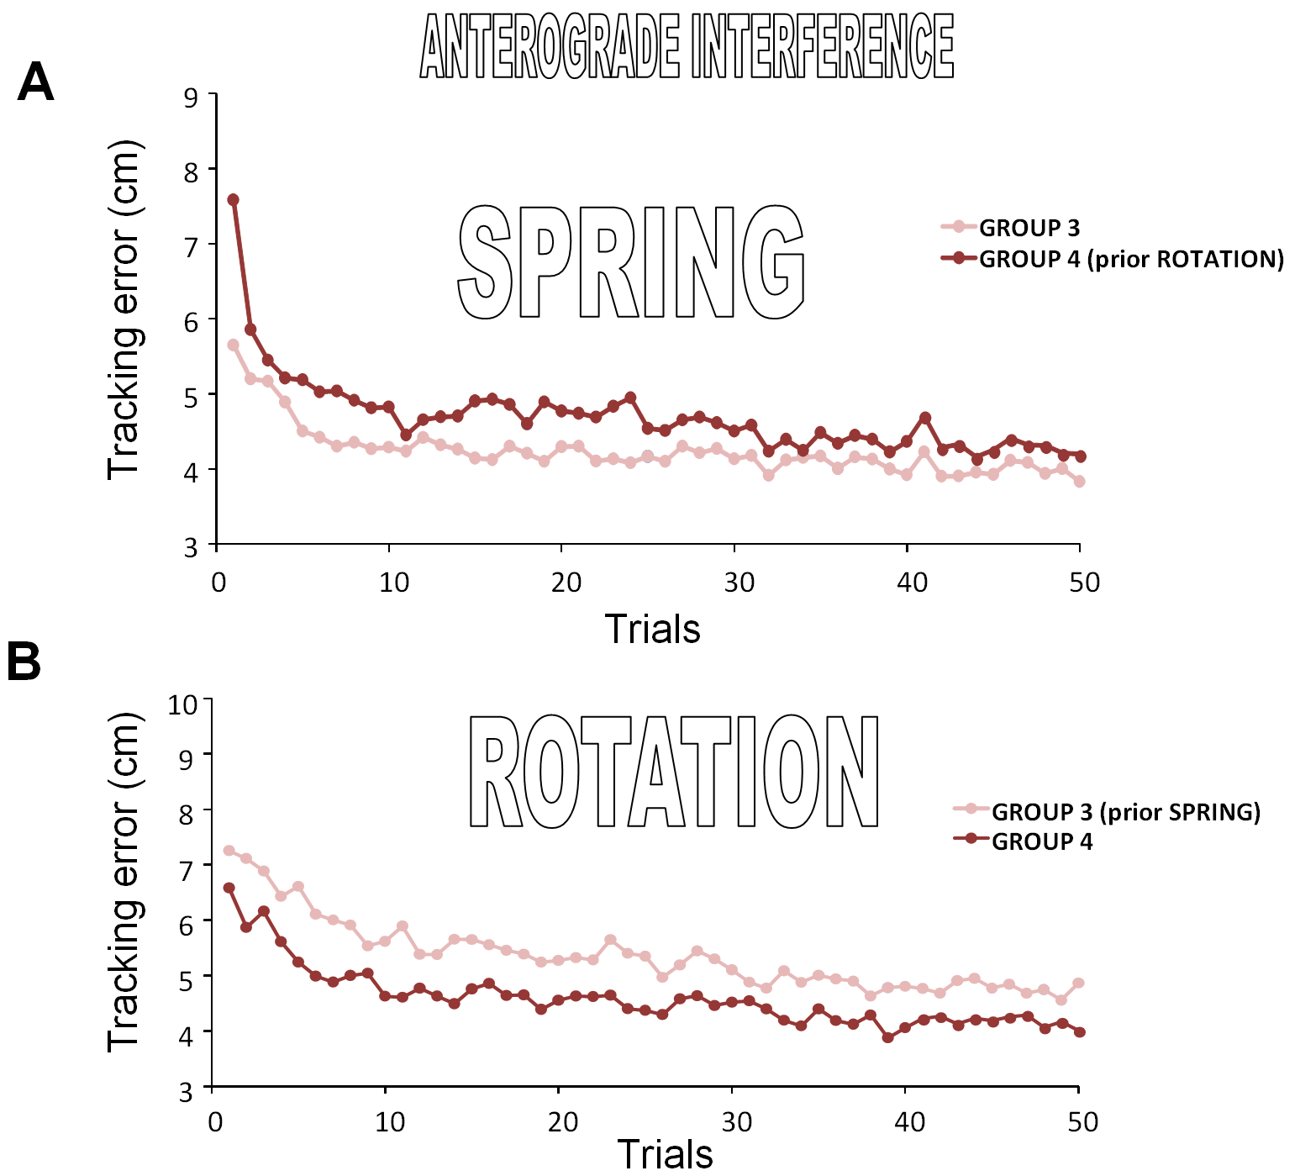
Results : Interference
G1
Spring
Rotation
SPROT
G2
Rotation
Spring
SPROT
G3
SPROT
Spring
Rotation
G4
SPROT
Rotation
Spring
Note in both cases the detrimental effect of prior experience with the other mapping

Slide 14
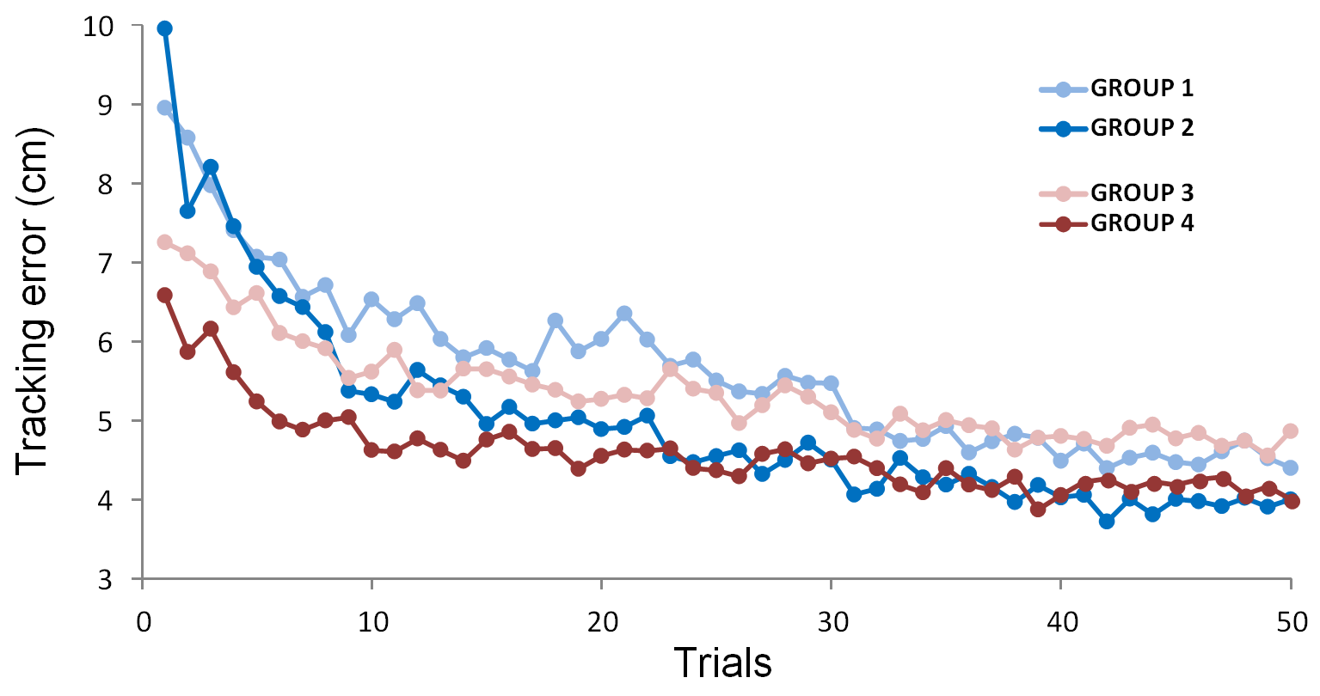
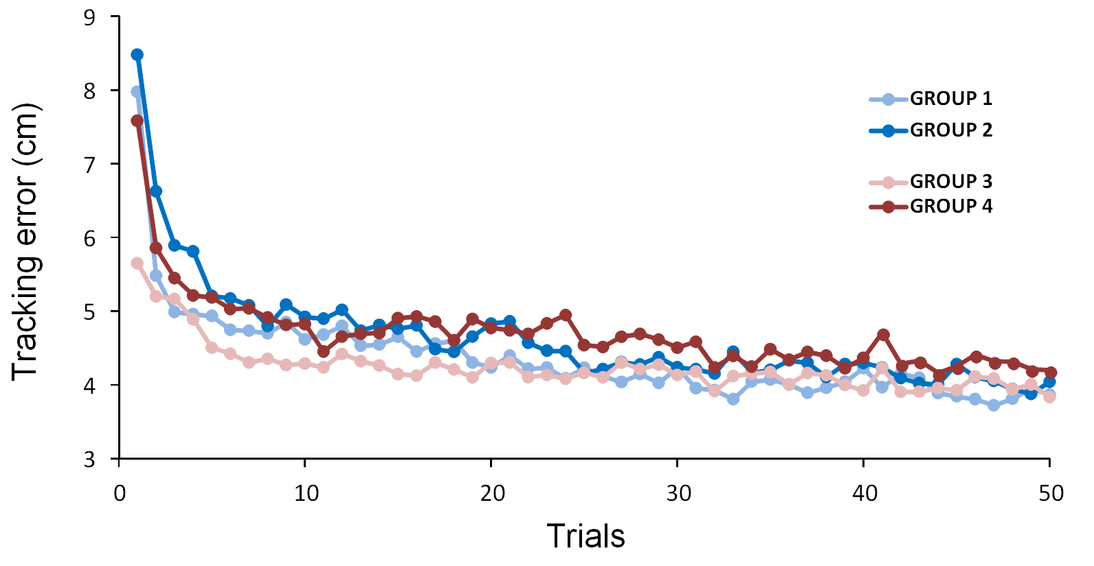
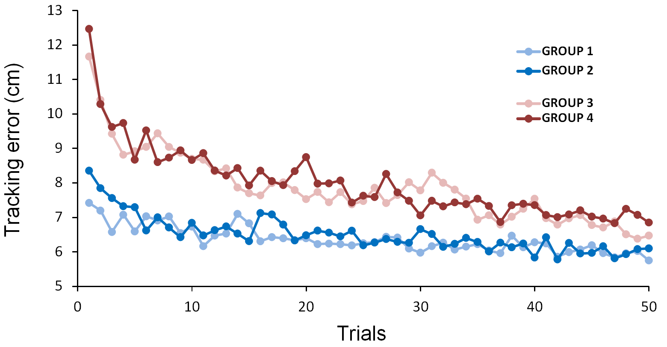
Results : Group Comparison
ROTATION
SPRING
SPROT
ROTATION : the lower initial error in GROUP 3 and 4 who previously experienced rotated visual feedback under the SPROT mapping.
SPRING : the lower initial error in GROUP 3 who was dealing with a mass-spring cursor under the SPROT mapping immediately before this block.
SPROT : the lower initial error in GROUP 1 and 2 that previously experienced the rotated and the mass-spring cursor mappings separately
G1
Spring
Rotation
SPROT
G2
Rotation
Spring
SPROT
G3
SPROT
Spring
Rotation
G4
SPROT
Rotation
Spring

Slide 15
Main Findings
Evidences for modularity were found both at the composition and decomposition levels.
Indeed, no matter the order of presentation, prior exposure to each individual mapping benefited to learning the combined mapping.
Moreover, prior exposure to the combined mapping facilitated learning of the isolated mapping that was first tested afterwards
Evidence for (anterograde) interference effect was found whenever participants switched from the SPRING to the ROTATION mapping, and vice versa.

Slide 16
Discussion
In terms of internal model architecture
Modularity
Single internal model
2 internal models
Interference
In terms of feedback adaptation mechanisms
Modularity
Interference

Slide 17
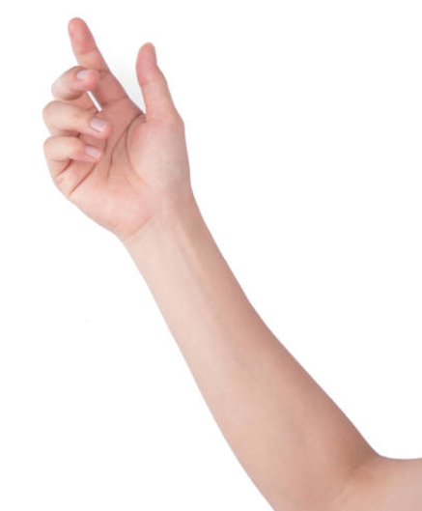

Discussion
Modularity in terms of internal models
Single internal model
One possibility is that the CNS learns a single internal model of the combined transformation and only later decomposes it into its component parts when required.
Learn in an integrated manner to further use these sensorimotor modules separately (decomposition from an integrated learning) (Flanagan et al., 1999; Ghahramani & Wolpert, 1997;Howard, Ingram, & Wolpert, 2008)
Integration unit : The system appears to require integrated practice to coordinate the adaptations and the networks involved in the integrated behavior (Burgos 2018)
Motor command
Desired target
Controller/
Inverse model
Visuo-proprioceptive mismatch
(Sensory FB error)
(Online)
Forward model
Expected FB
Actual sensory FB

Slide 18
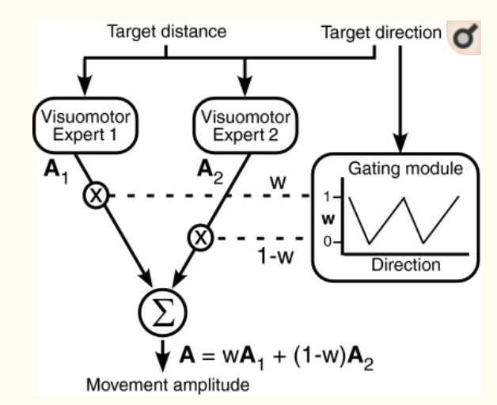
Discussion
Modularity in terms of internal models
2 internal models
It is possible to learn separated modules of adaptations (Haruno, Wolpert, & Kawato, 2001), then improve on a combined performance.
Internal models of the separate transformations are acquired simultaneously during adaptation to the combined transformation (Ghahramani and Wolpert 1997)
A complex visuomotor task can be divided into simpler subtasks, each learned by a separate module in the brain (expert modules - Pearson et al 2010).
Internal models of kinematic and dynamic sensorimotor transformations are learned independently (Krakauer et al., 1999).
Controller/
Inverse model2
Motor command
Desired target
Controller/
Inverse model
Forward model2
Visuo-proprioceptive mismatch
(Sensory FB error)
(Online)
Forward model
Expected FB
Actual sensory FB

Slide 19
Discussion
Modularity in terms of internal models
Single internal model
During SPROT, a single integrated internal model can be learned
And during the transfer phase, this decomposes , this explains good transfer.
Novelty is, in our case, a single integrated motor memory formation happens within the same trial for 2 kinematic perturbations.
2 internal models
During SPROT, 2 internal models can be learned (one for ROT and one for SPR, it is cool !) simultaneously, accommodating and identifying different task environments within the trial.
And during the transfer phase, the appropriate switch happens, this explains good transfer.
Novelty is, in our case, two separate internal model (motor memory) formation happens within the same trial for 2 kinematic perturbations.

Slide 20
Discussion
Comment on interference:
No interference while learning successively :
A visual rotation & a lateral arm mass (different kinematic variables Krakauer et al. 1999)
A visual rotation & a viscous force field (Flanagan et al. 1999, random design –Summa et al 2012))
2 visuomotor rotation in two tasks - lack of interference suggests that memory resources for visuomotor rotations are task specific. (Tong & Flanagan 2003)
Interference occurs while learning successively :
2 equal and opposite position-dependent visuomotor rotations (Krakauer et al., 1999, Wigmore et al. 2002)
2 equal and opposite velocity-dependent forcefields (Brashers-Krug et al., 1996, Shadmehr & Brashers-Krug 1997)
Visual and a mechanical distortion yield interference when linked to the same kinematic variable (Tong et al. 2002).
Anterograde interference was observed between two transformations of common physical nature (i.e., visual), but different kinematic coupling. (Bock 2003) – This may be our case. 2 visual pert with different kinematic variables ROT (pos) & SPR (vel)?
Interference in terms of internal model
The change in task provides contextual cues that trigger the allocation of separate working memory resources for a new internal model ( Tong 2003)
The Tong et al. (2002) results suggest that internal models for novel kinematic and dynamic perturbations may share common resources.
In our case interference occurs because the internal models of ROT & SPR share common resources (single IM?)
Single neural network with nodes for ROT & SPR, some shared (dep. var.), some unique (independent var)

Slide 21
Discussion
Modularity in terms of feedback adaptation mechanisms:
In this continuous tracking task, explicit knowledge/strategy is impossible, so the contribution of the feedforward component (predictions about the rotation) is limited.
Learning is happening online with respect to the updation of (visuo-proprioceptive) feedback mechanism (feedback adaptation).
In line with that, our findings suggest that, during SPROT, the feedback response is learned as a sum and it can be decomposed later according to the need of task environment.
Within same trial, multiple feedback correction components can be learned OR from a COMPOSITE feedback adaptation sequence, multiple feedback adaptation sequence could be retrieved.
Components of feedback adaptation of kinematic perturbation are separable
Interference in terms of feedback adaptation mechanisms:
Feedback adaptation for 2 different kinematic task representations are subjected to anterograde interference
Feedback adaptation follows principles of modularity and interference

Slide 22
Discussion
Feedback adaptation
Motor command
Desired target
Feedback controller
SPR+ROT Feedback mediated online correction2
SPR+ROT Feedback mediated online correction1
SPR+ROT Feedback mediated online correction3
Visuo-proprioceptive mismatch
(Sensory error)
(Online)
Forward model
Expected FB
1st 2nd 3rd 4th 5th
Actual sensory FB
SPROT Feedback adaptation
SPR Feedback adaptation
ROT Feedback adaptation
SPR Feedback adaptation
SPROT Feedback adaptation
SPROT Feedback adaptation
ROT Feedback adaptation

Slide 23
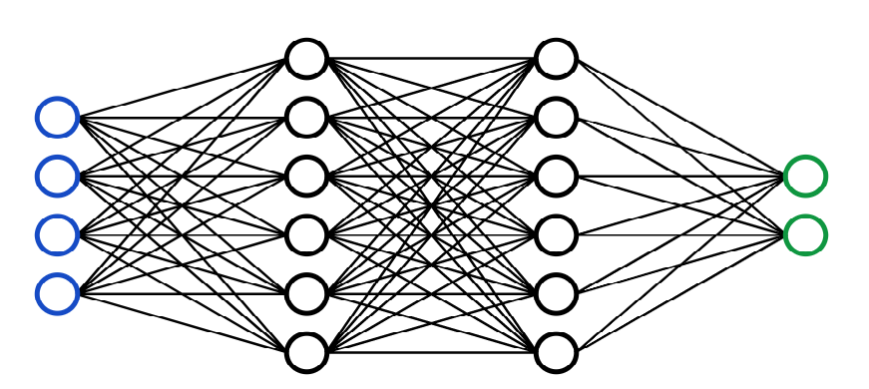
Discussion
Possible Network
Feedback controller
Dynamic
During SPROT
In agreement with modularity
ROT
Shared nw
Kinematic
SPR
ROT
Shared nw
During ROT
In agreement with interference
SPR
proprio
visual
ROT
Shared nw
Forward model
proprio
During SPR
visuo-proprio
Shared nw
SPR
visual
State estimator

Slide 24
Summary
People can learn complex kinematic perturbations
Visuomotor rotation and mass-spring (No haptic) mapping are two forms of visuomotor perturbations that presumably rely on overlapping neural substrate because of good modularity & good anterograde interference
After combined adaptation, it is easy to separate them & after separate adaptation, it is easy to combine them
Interference occurs may be because the internal models of two kinematic perturbations of share common resources (single internal model ?)
It is possible to separate components of feedback adaptation of complex kinematic perturbation
Feedback adaptation of common physical nature (i.e., visual), but different kinematic coupling follows principles of modularity and interference

Slide 25
Merci Beaucoup

Slide 26
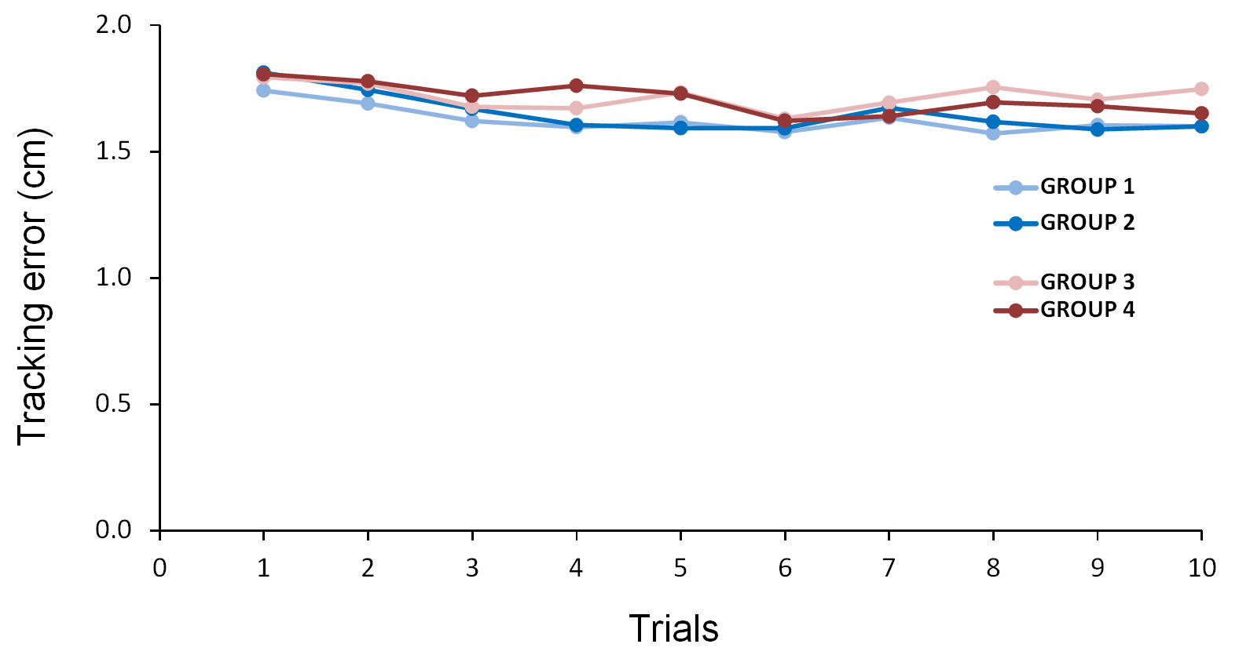
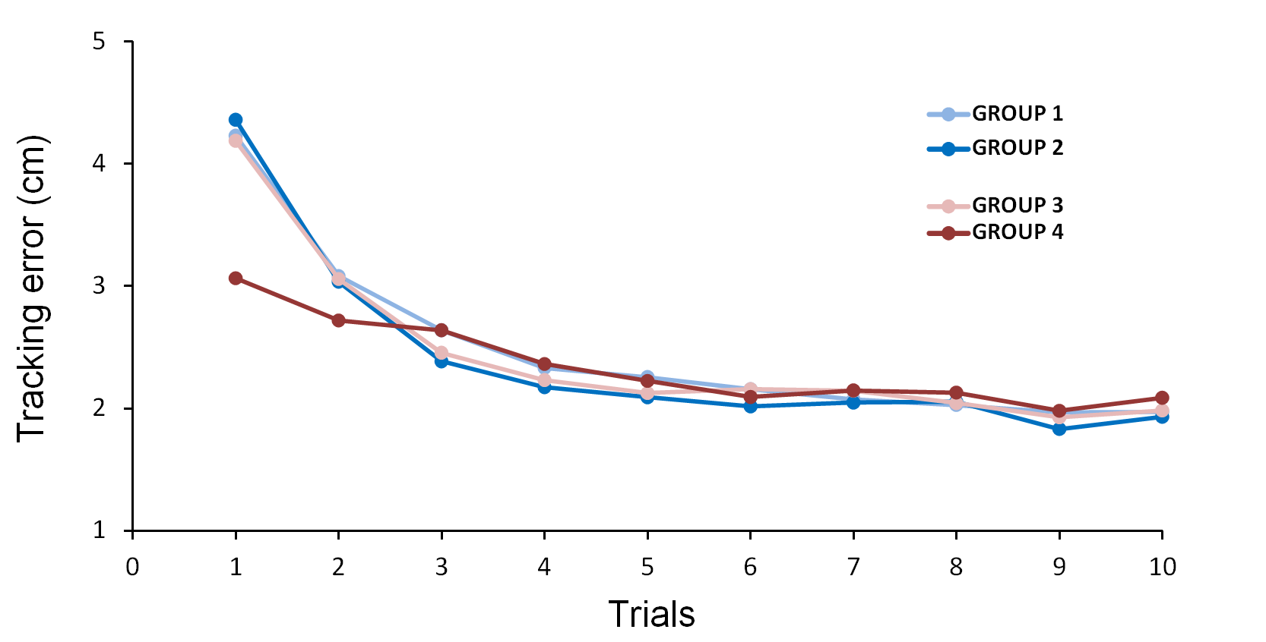
washout
Baseine

